Slide 1
Final presentation foot-based activity recognition
Untertitel: Arial 18pt fett
Auch mehrzeilig möglich.

Slide 2
Table of contents
Goal of our project
Overview
Movements
Hardware scheme
Sensor data output
Machine learning pipeline
Graphic user interface
Results of the Evaluation

Slide 3
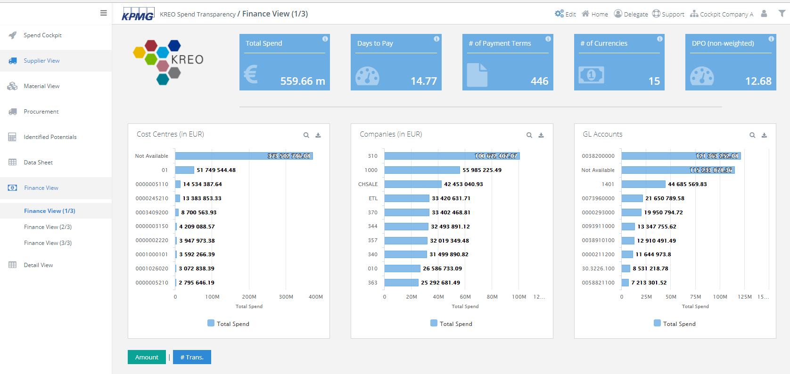
Goal
Mid-term presentation
Design a foot-based movement recognition system
Controls can be mapped to interact with KPMG Dashboards and other applications (presentations, software development and others)
We focus on usability and reliability in everyday use

Slide 4
Overview
Programming language used: Python
Project organisation: Gannt diagram

Slide 5
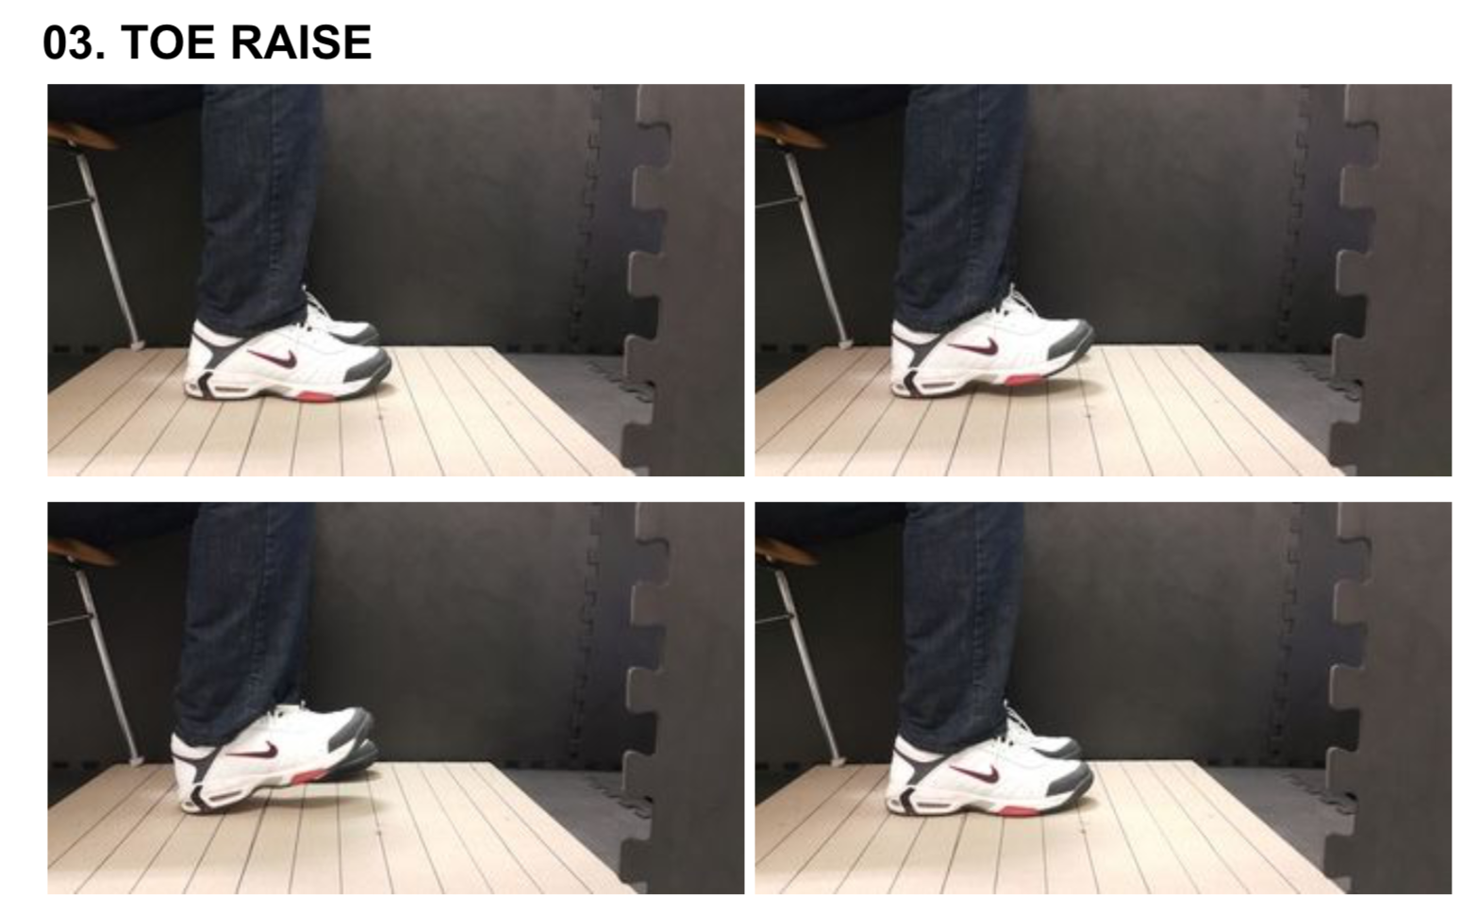
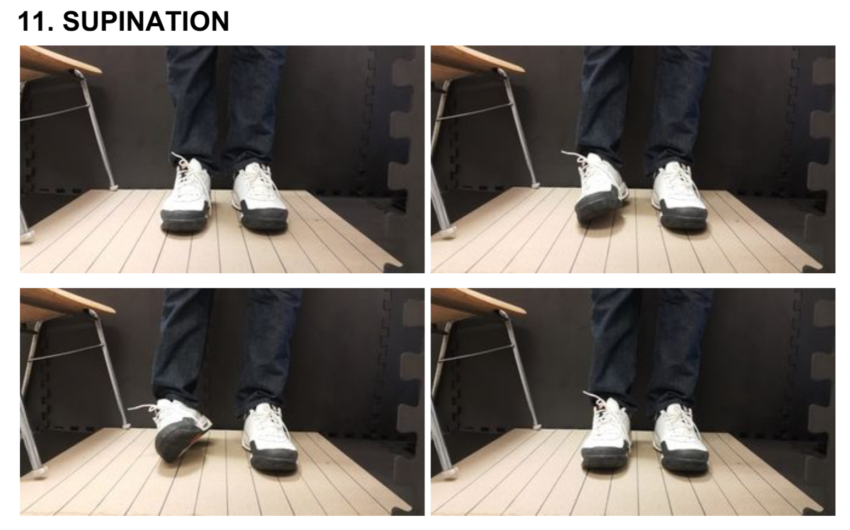
Movements
Movements should be easy to use in an everyday office environment
Implemented movements:
Toe and heel raise
Suspination and pronation
Front and Back slide
Rotate toe left and right
Mid-term presentation

Slide 6
Movements
Mid-term presentation
Movements should be easy to use in an everyday office environment
Implemented movements:
Toe and heel raise
Suspination and pronation
Front and Back slide
Rotate toe left and right
Toe and heel raise
Suspination and pronation
Front and Back slide
Rotate toe left and right

Slide 7
Movements
Mid-term presentation
Movements should be easy to use in an everyday office environment
Movements and mapped functions in the demo:
Toe and heel raise
Suspination and pronation
Front and Back slide
Rotate toe left and right
Next or previous graph
Redraw graph in next or previous ode
Zoom in or out
Next or previous year

Slide 8
Machine learning pipeline
Implemented using the „sklearn“ bibliothek
More than 200 data sets were recorded and used as labeled sets for training
We used cross validation for XXX, but these were also good
A combination of integral and furier transformations are used for the feature extraction
For the classification we use this algorithm
The following algorithms were tried, but replaced because…

Slide 9
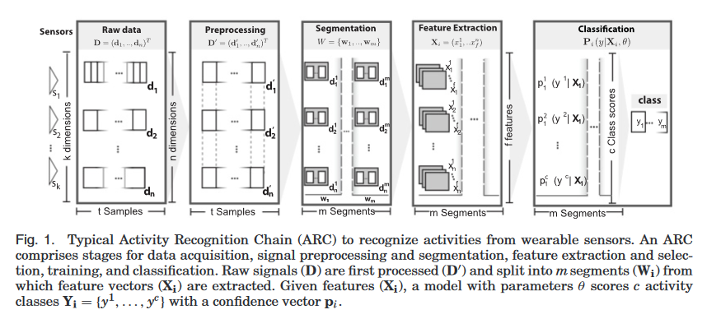
Next Steps
Finish implementing the (machine learning) pipeline
Implement a user interface
Finish the documentation and create the final presentation

Slide 10
Evaluation - Overview
The goal was to asses the usability of our foot-bases sensor
The structure of the evaluation:
Instruction on the process of the evaluation
The participants are given set of tasks to perform.
The opinion of the participants and performance indicators are measured

Slide 11
Evaluation - Results
Multiple pie and bar charts will be made to represent the results of the evaluation
The evaluation had XXX participants
Results that should be shown:
F1 Measure (or Precision and Recall)
Each tasks difficulty to perform: 1 - 5
Precision of sensor: 1 - 5
Usability of sensor: 1 - 5
Would you use it in your everyday work? (Given the sensor would be smaller, wireless and with a good battery) 1 - 5

Slide 12
Possible applications
The foot sensor can be used as an input device, similar to the use of a mouse or keyboard
Individual control binding enables a highly personalized use
Frees the hands
Use the sensor as a second mouse, which eliminates the need to take the hands from the keyboard

Slide 13
Movements
Movements should be easy to use in an everyday office environment
Planned movements and mapped actions (excerpt):
Toe and heel raise → zoom in or out on the dasboard
One foot hover → end current application (Alt + F4)
Toe tap → scrolling
Left and right side supination → scrolling
Slides → scrolling up or down
Toe and heel rotation → swipe to next or previous dashboard

Slide 14
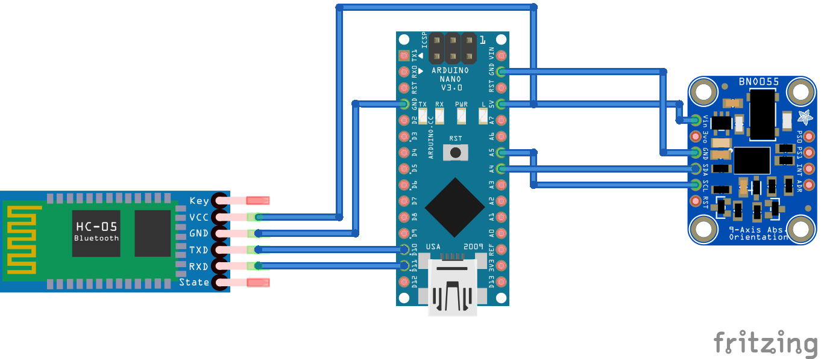
Hardware scheme
Our Hardware consist of three components (left to right):
Bluetooth module, Arduino and the sensor module

Slide 15
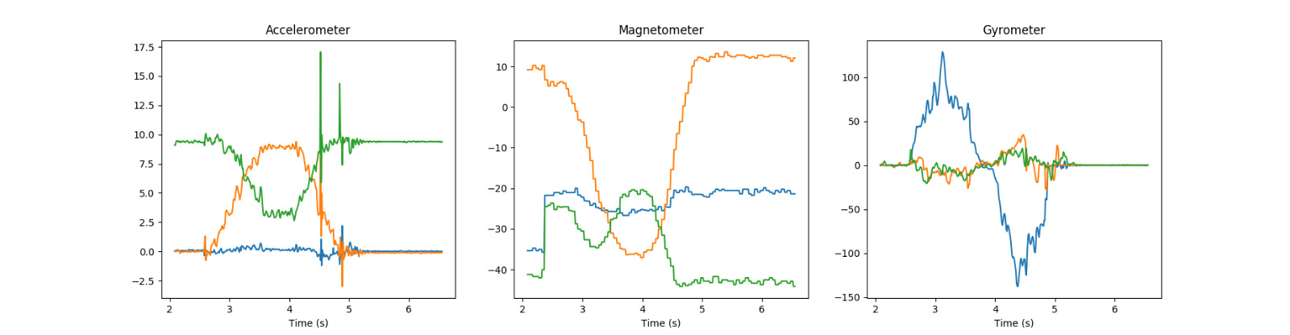
Sensor data output
This is the data we receive from out sensor for the movement „suspination“
In the future the system can differentiate between the movements based on the data alone

Slide 16
Dashboard

Slide 17
Masterfolie (über: Ansicht – Master – Folienmaster)
Die Masterfolie wird genutzt, um grundlegende Elemente der Präsentation festzulegen und ggf. zu ändern.
Folgende Elemente können Sie in der Normalansicht individuell eintragen:
Inhaltsbereich:
Präsentationsüberschrift
Unterüberschrift
Fakultätsbezeichnung
Bildaustausch (graue Lasche am rechten Folienrand – zum leichteren Austausch)
Fußzeile (über: Ansicht – Kopf- und Fußzeile)

Slide 18
Folientitel: Arial 24pt fett 2-zeilig: Arial 20pt fett
Fließtext: Arial 24pt regular
Fußzeile: Arial 9pt regular
Seitenzahl: Arial 9pt fett
Aufzählungspunkte, falls nicht auf Folie vorhanden:
Format – Nummerierung- und Aufzählungszeichen – Bild – Importieren
Die Datei „kit-point.png“ auswählen
Größe: „70% vom Text“
Farben:
Sind bereits voreingestellt. Sie erhalten automatisch die KIT-Farbpalette
08.07.2018

Slide 19
Generelle Hinweise
Das Foliendesign sollte nicht geändert werden
Wenn Sie aus einem anderen Office-Programm Texte kopieren, wird Powerpoint die Formatierungen beibehalten. Hier müssen Sie die Texte evtl. neu formatieren.
Grundlegende Elemente wie diese im grauen KIT-Rahmen, das KIT-Logo oder die Platzhalter sollten in der Position nicht verändert oder gelöscht werden.

Slide 20
Tipps zur Verwendung von Powerpoint
Seitenaufbau
Text und Grafiken: Diese Elemente sollten gezielt und zurückhaltend eingesetzt werden. Empfohlen werden zehn Worte pro Zeile und fünf Zeilen pro Folie.
Zahlen und Daten Effektive PowerPoint-Präsentationen enthalten wenig Zahlen: ausführliche Daten können Sie nach der Präsentation auf Handouts verteilen.

